Slide 1
React
Введение

Slide 2
План
Что такое React и зачем он нужен
Базовая функциональность
JSX
Virtual dom and reconcialtion
Компоненты
Props state handlers

Slide 3
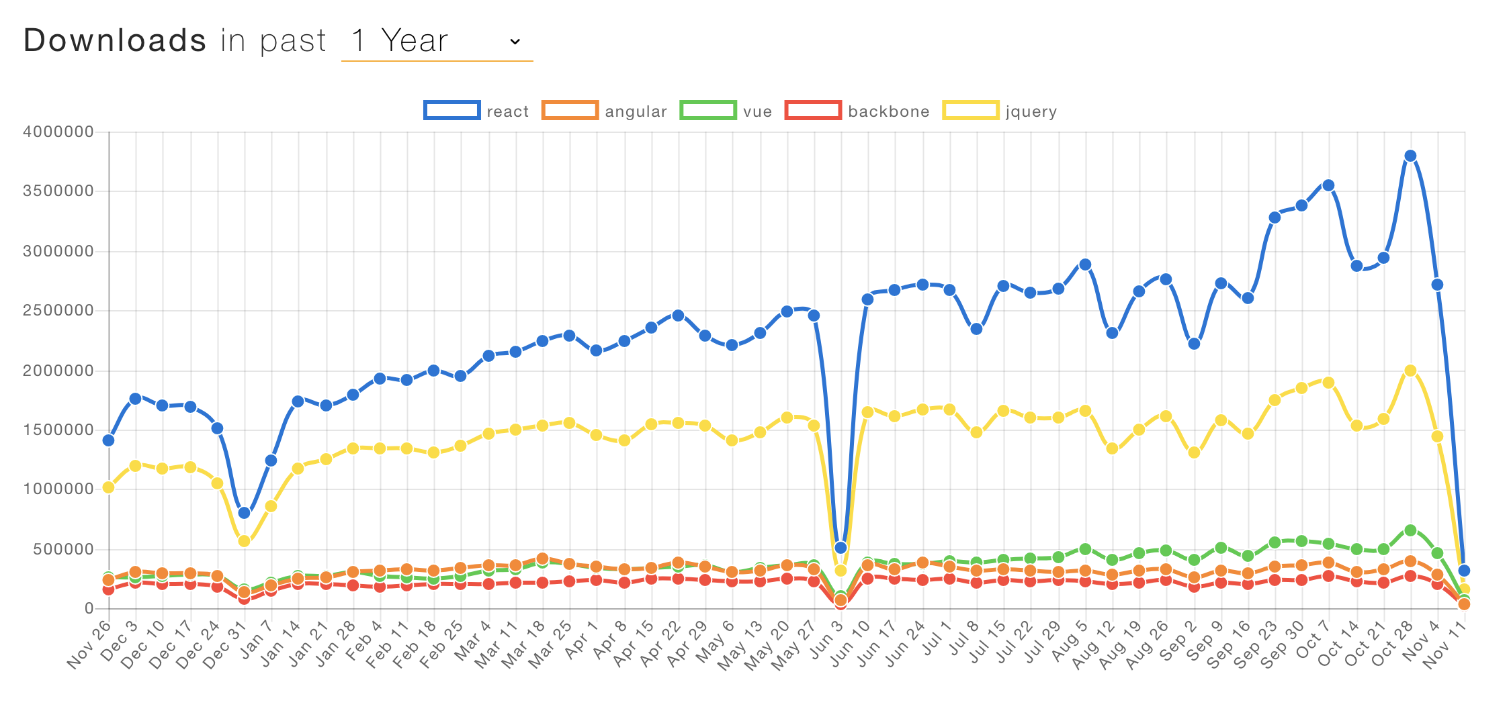

Slide 4
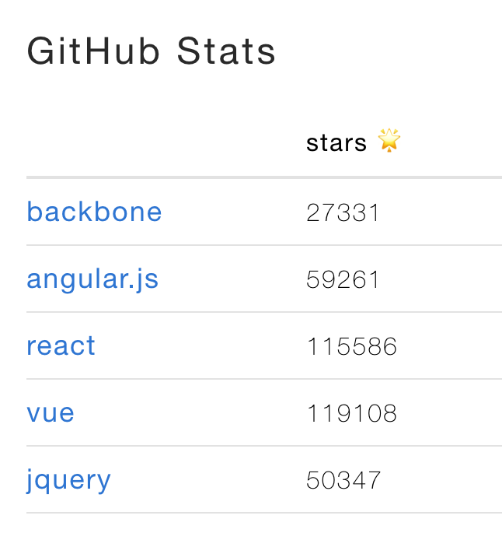

Slide 6
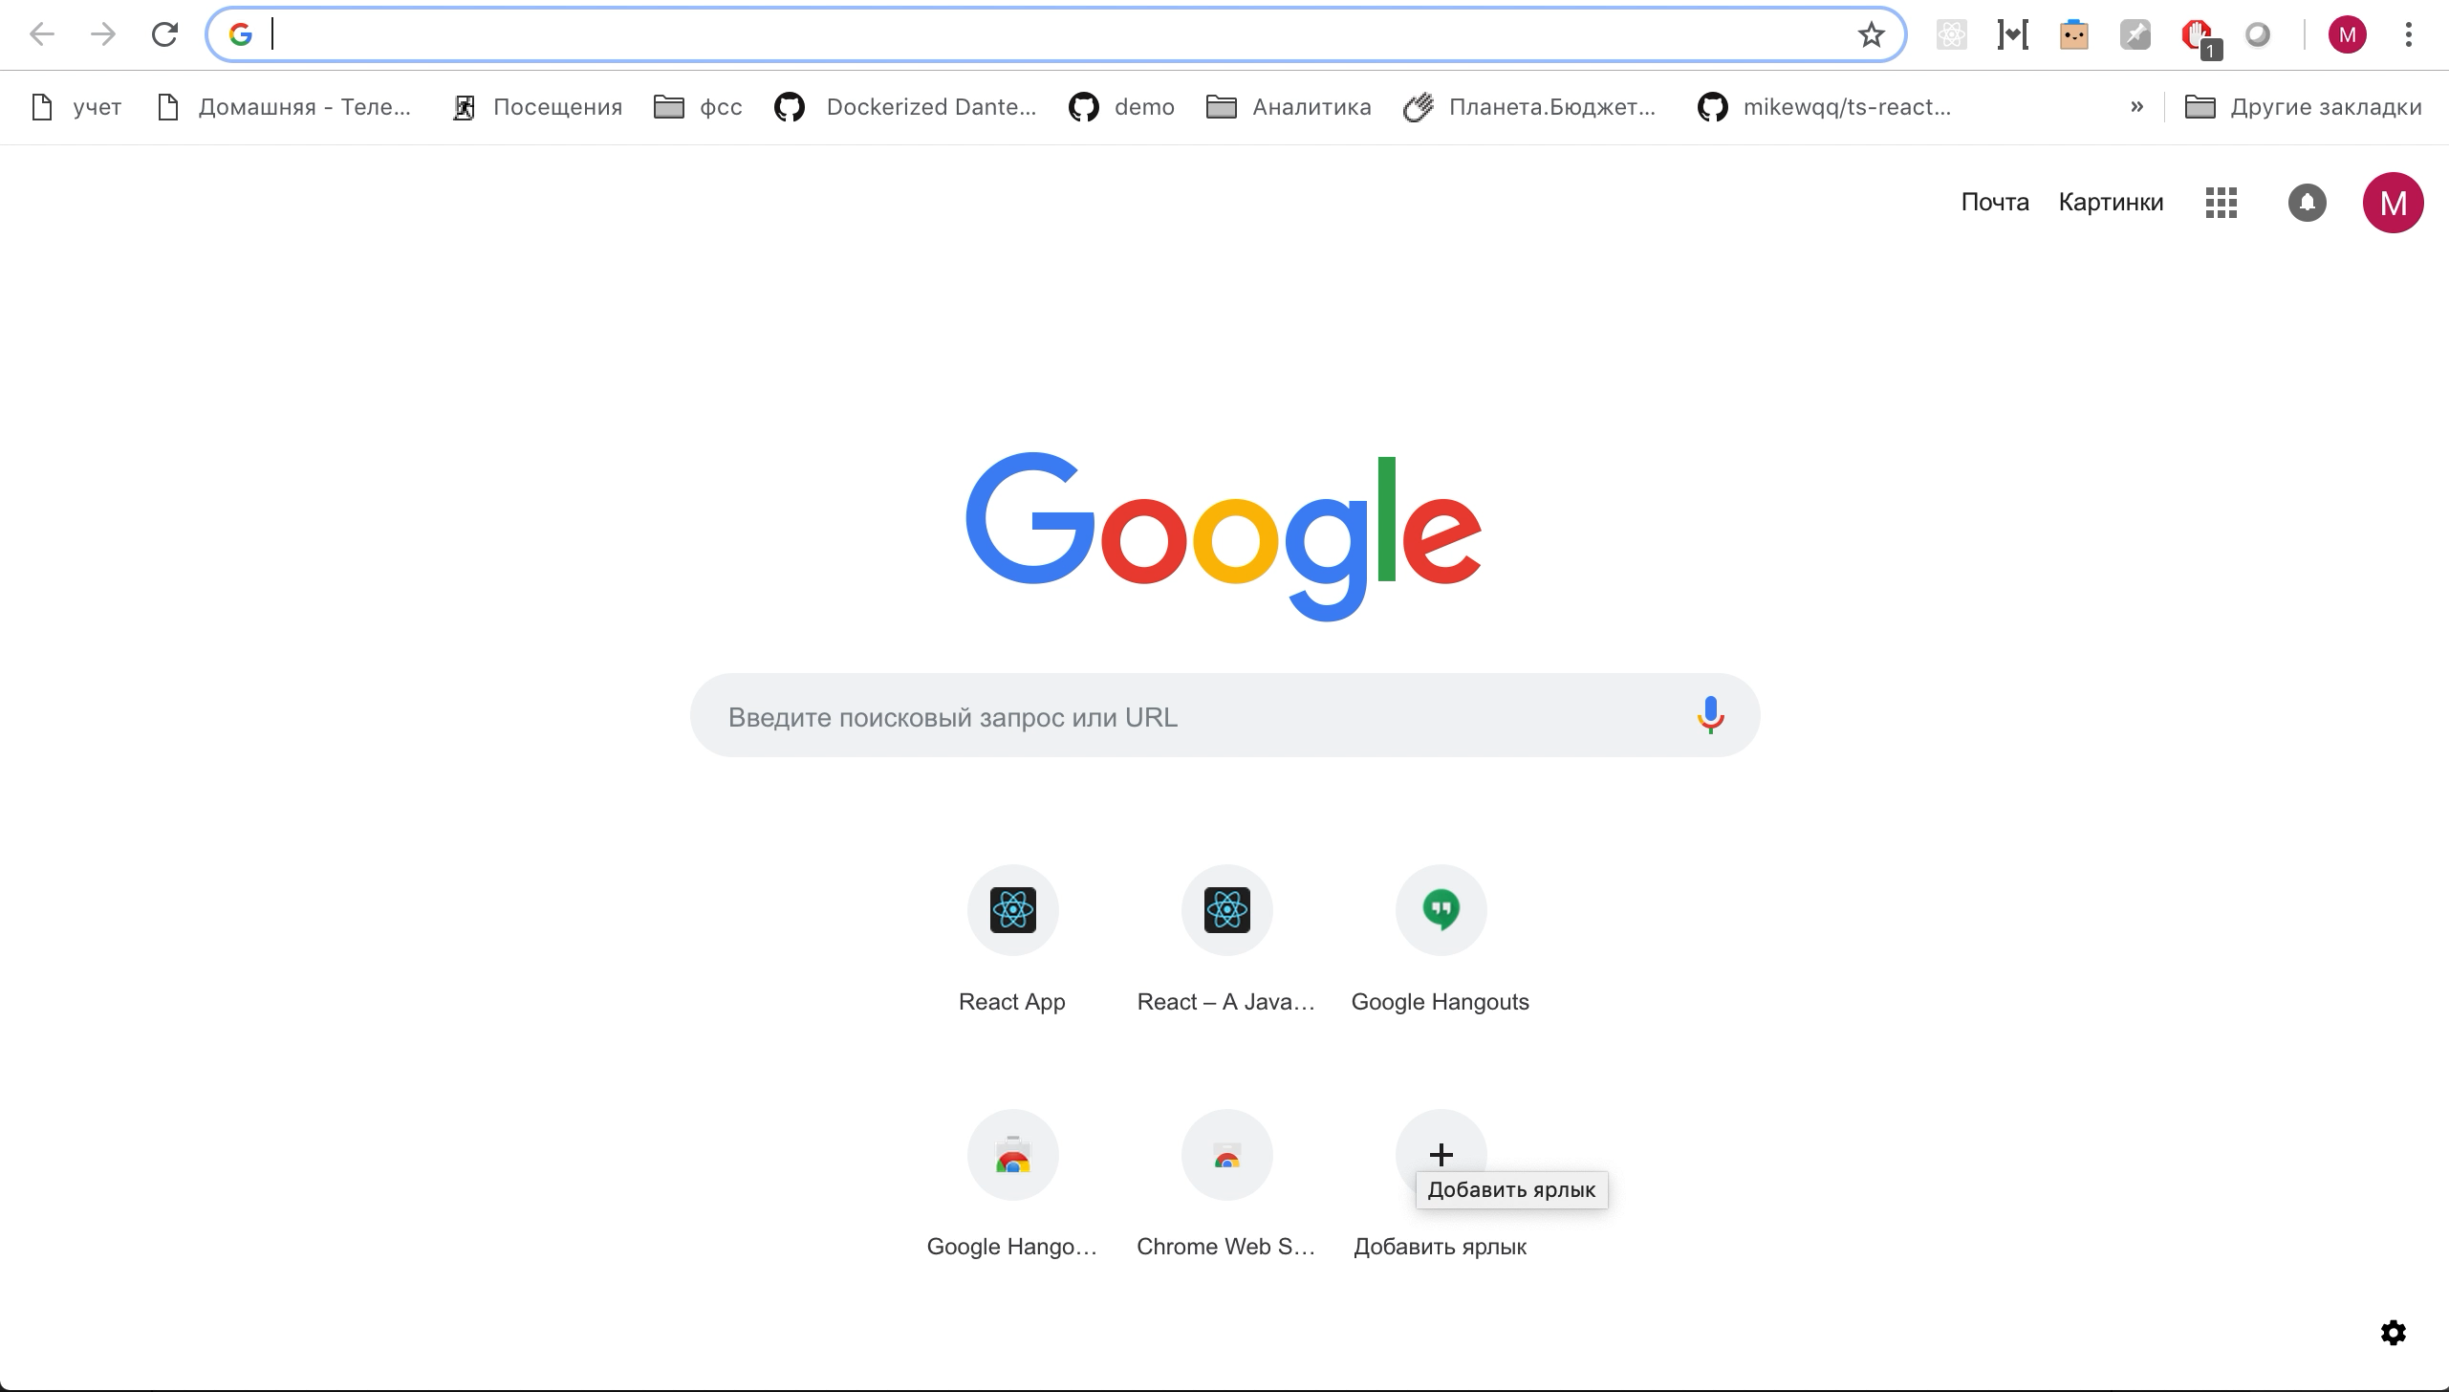
Что такое React

Slide 7
Немного про javascript

Slide 8
T_T
[][(![]+[])[+[]]+([![]]+[][[]])[+!+[]+[+[]]]+(![]+[])[!+[]+!+[]]+(!![]+[])[+[]]+(!![]+[])[!+[]+!+[]+!+[]]+(!![]+[])[+!+[]]][([][(![]+[])[+[]]+([![]]+[][[]])[+!+[]+[+[]]]+(![]+[])[!+[]+!+[]]+(!![]+[])[+[]]+(!![]+[])[!+[]+!+[]+!+[]]+(!![]+[])[+!+[]]]+[])[!+[]+!+[]+!+[]]+(!![]+[][(![]+[])[+[]]+([![]]+[][[]])[+!+[]+[+[]]]+(![]+[])[!+[]+!+[]]+(!![]+[])[+[]]+(!![]+[])[!+[]+!+[]+!+[]]+(!![]+[])[+!+[]]])[+!+[]+[+[]]]+([][[]]+[])[+!+[]]+(![]+[])[!+[]+!+[]+!+[]]+(!![]+[])[+[]]+(!![]+[])[+!+[]]+([][[]]+[])[+[]]+([][(![]+[])[+[]]+([![]]+[][[]])[+!+[]+[+[]]]+(![]+[])[!+[]+!+[]]+(!![]+[])[+[]]+(!![]+[])[!+[]+!+[]+!+[]]+(!![]+[])[+!+[]]]+[])[!+[]+!+[]+!+[]]+(!![]+[])[+[]]+(!![]+[][(![]+[])[+[]]+([![]]+[][[]])[+!+[]+[+[]]]+(![]+[])[!+[]+!+[]]+(!![]+[])[+[]]+(!![]+[])[!+[]+!+[]+!+[]]+(!![]+[])[+!+[]]])[+!+[]+[+[]]]+(!![]+[])[+!+[]]]((![]+[])[+!+[]]+(![]+[])[!+[]+!+[]]+(!![]+[])[!+[]+!+[]+!+[]]+(!![]+[])[+!+[]]+(!![]+[])[+[]]+(![]+[][(![]+[])[+[]]+([![]]+[][[]])[+!+[]+[+[]]]+(![]+[])[!+[]+!+[]]+(!![]+[])[+[]]+(!![]+[])[!+[]+!+[]+!+[]]+(!![]+[])[+!+[]]])[!+[]+!+[]+[+[]]]+([]+[])[(![]+[])[+[]]+(!![]+[][(![]+[])[+[]]+([![]]+[][[]])[+!+[]+[+[]]]+(![]+[])[!+[]+!+[]]+(!![]+[])[+[]]+(!![]+[])[!+[]+!+[]+!+[]]+(!![]+[])[+!+[]]])[+!+[]+[+[]]]+([][[]]+[])[+!+[]]+(!![]+[])[+[]]+([][(![]+[])[+[]]+([![]]+[][[]])[+!+[]+[+[]]]+(![]+[])[!+[]+!+[]]+(!![]+[])[+[]]+(!![]+[])[!+[]+!+[]+!+[]]+(!![]+[])[+!+[]]]+[])[!+[]+!+[]+!+[]]+(!![]+[][(![]+[])[+[]]+([![]]+[][[]])[+!+[]+[+[]]]+(![]+[])[!+[]+!+[]]+(!![]+[])[+[]]+(!![]+[])[!+[]+!+[]+!+[]]+(!![]+[])[+!+[]]])[+!+[]+[+[]]]+(![]+[])[!+[]+!+[]]+(!![]+[][(![]+[])[+[]]+([![]]+[][[]])[+!+[]+[+[]]]+(![]+[])[!+[]+!+[]]+(!![]+[])[+[]]+(!![]+[])[!+[]+!+[]+!+[]]+(!![]+[])[+!+[]]])[+!+[]+[+[]]]+(!![]+[])[+!+[]]]()[+!+[]+[!+[]+!+[]]]+(+(+!+[]+[+[]]+[+!+[]]))[(!![]+[])[+[]]+(!![]+[][(![]+[])[+[]]+([![]]+[][[]])[+!+[]+[+[]]]+(![]+[])[!+[]+!+[]]+(!![]+[])[+[]]+(!![]+[])[!+[]+!+[]+!+[]]+(!![]+[])[+!+[]]])[+!+[]+[+[]]]+(+![]+([]+[])[([][(![]+[])[+[]]+([![]]+[][[]])[+!+[]+[+[]]]+(![]+[])[!+[]+!+[]]+(!![]+[])[+[]]+(!![]+[])[!+[]+!+[]+!+[]]+(!![]+[])[+!+[]]]+[])[!+[]+!+[]+!+[]]+(!![]+[][(![]+[])[+[]]+([![]]+[][[]])[+!+[]+[+[]]]+(![]+[])[!+[]+!+[]]+(!![]+[])[+[]]+(!![]+[])[!+[]+!+[]+!+[]]+(!![]+[])[+!+[]]])[+!+[]+[+[]]]+([][[]]+[])[+!+[]]+(![]+[])[!+[]+!+[]+!+[]]+(!![]+[])[+[]]+(!![]+[])[+!+[]]+([][[]]+[])[+[]]+([][(![]+[])[+[]]+([![]]+[][[]])[+!+[]+[+[]]]+(![]+[])[!+[]+!+[]]+(!![]+[])[+[]]+(!![]+[])[!+[]+!+[]+!+[]]+(!![]+[])[+!+[]]]+[])[!+[]+!+[]+!+[]]+(!![]+[])[+[]]+(!![]+[][(![]+[])[+[]]+([![]]+[][[]])[+!+[]+[+[]]]+(![]+[])[!+[]+!+[]]+(!![]+[])[+[]]+(!![]+[])[!+[]+!+[]+!+[]]+(!![]+[])[+!+[]]])[+!+[]+[+[]]]+(!![]+[])[+!+[]]])[+!+[]+[+[]]]+(!![]+[])[+[]]+(!![]+[])[+!+[]]+([![]]+[][[]])[+!+[]+[+[]]]+([][[]]+[])[+!+[]]+(+![]+[![]]+([]+[])[([][(![]+[])[+[]]+([![]]+[][[]])[+!+[]+[+[]]]+(![]+[])[!+[]+!+[]]+(!![]+[])[+[]]+(!![]+[])[!+[]+!+[]+!+[]]+(!![]+[])[+!+[]]]+[])[!+[]+!+[]+!+[]]+(!![]+[][(![]+[])[+[]]+([![]]+[][[]])[+!+[]+[+[]]]+(![]+[])[!+[]+!+[]]+(!![]+[])[+[]]+(!![]+[])[!+[]+!+[]+!+[]]+(!![]+[])[+!+[]]])[+!+[]+[+[]]]+([][[]]+[])[+!+[]]+(![]+[])[!+[]+!+[]+!+[]]+(!![]+[])[+[]]+(!![]+[])[+!+[]]+([][[]]+[])[+[]]+([][(![]+[])[+[]]+([![]]+[][[]])[+!+[]+[+[]]]+(![]+[])[!+[]+!+[]]+(!![]+[])[+[]]+(!![]+[])[!+[]+!+[]+!+[]]+(!![]+[])[+!+[]]]+[])[!+[]+!+[]+!+[]]+(!![]+[])[+[]]+(!![]+[][(![]+[])[+[]]+([![]]+[][[]])[+!+[]+[+[]]]+(![]+[])[!+[]+!+[]]+(!![]+[])[+[]]+(!![]+[])[!+[]+!+[]+!+[]]+(!![]+[])[+!+[]]])[+!+[]+[+[]]]+(!![]+[])[+!+[]]])[!+[]+!+[]+[+[]]]](!+[]+!+[]+[+!+[]])[+!+[]]+(!![]+[])[!+[]+!+[]+!+[]]+(![]+[])[!+[]+!+[]]+(![]+[])[!+[]+!+[]]+(!![]+[][(![]+[])[+[]]+([![]]+[][[]])[+!+[]+[+[]]]+(![]+[])[!+[]+!+[]]+(!![]+[])[+[]]+(!![]+[])[!+[]+!+[]+!+[]]+(!![]+[])[+!+[]]])[+!+[]+[+[]]]+(+[![]]+[][(![]+[])[+[]]+([![]]+[][[]])[+!+[]+[+[]]]+(![]+[])[!+[]+!+[]]+(!![]+[])[+[]]+(!![]+[])[!+[]+!+[]+!+[]]+(!![]+[])[+!+[]]])[+!+[]+[+!+[]]]+(!![]+[])[+!+[]]+(!![]+[])[!+[]+!+[]+!+[]]+(![]+[])[+!+[]]+([][(![]+[])[+[]]+([![]]+[][[]])[+!+[]+[+[]]]+(![]+[])[!+[]+!+[]]+(!![]+[])[+[]]+(!![]+[])[!+[]+!+[]+!+[]]+(!![]+[])[+!+[]]]+[])[!+[]+!+[]+!+[]]+(!![]+[])[+[]]+([]+[])[(![]+[])[+[]]+(!![]+[][(![]+[])[+[]]+([![]]+[][[]])[+!+[]+[+[]]]+(![]+[])[!+[]+!+[]]+(!![]+[])[+[]]+(!![]+[])[!+[]+!+[]+!+[]]+(!![]+[])[+!+[]]])[+!+[]+[+[]]]+([][[]]+[])[+!+[]]+(!![]+[])[+[]]+([][(![]+[])[+[]]+([![]]+[][[]])[+!+[]+[+[]]]+(![]+[])[!+[]+!+[]]+(!![]+[])[+[]]+(!![]+[])[!+[]+!+[]+!+[]]+(!![]+[])[+!+[]]]+[])[!+[]+!+[]+!+[]]+(!![]+[][(![]+[])[+[]]+([![]]+[][[]])[+!+[]+[+[]]]+(![]+[])[!+[]+!+[]]+(!![]+[])[+[]]+(!![]+[])[!+[]+!+[]+!+[]]+(!![]+[])[+!+[]]])[+!+[]+[+[]]]+(![]+[])[!+[]+!+[]]+(!![]+[][(![]+[])[+[]]+([![]]+[][[]])[+!+[]+[+[]]]+(![]+[])[!+[]+!+[]]+(!![]+[])[+[]]+(!![]+[])[!+[]+!+[]+!+[]]+(!![]+[])[+!+[]]])[+!+[]+[+[]]]+(!![]+[])[+!+[]]]()[+!+[]+[!+[]+!+[]]]+(!![]+[][(![]+[])[+[]]+([![]]+[][[]])[+!+[]+[+[]]]+(![]+[])[!+[]+!+[]]+(!![]+[])[+[]]+(!![]+[])[!+[]+!+[]+!+[]]+(!![]+[])[+!+[]]])[!+[]+!+[]+[+[]]])()

Slide 9
Разминка
sum(1)(2) === 3;

Slide 10
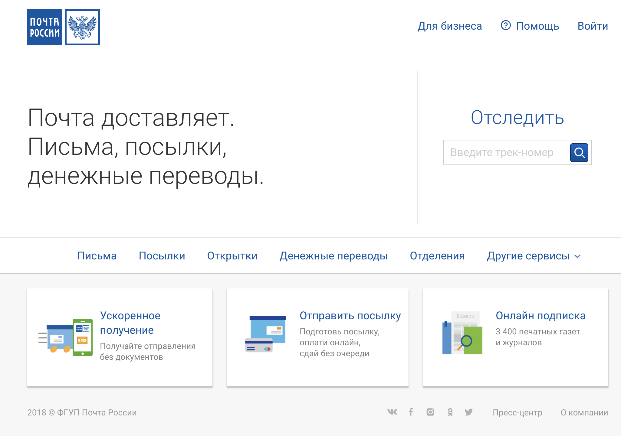
Компоненты

Slide 11
Компоненты

Slide 12
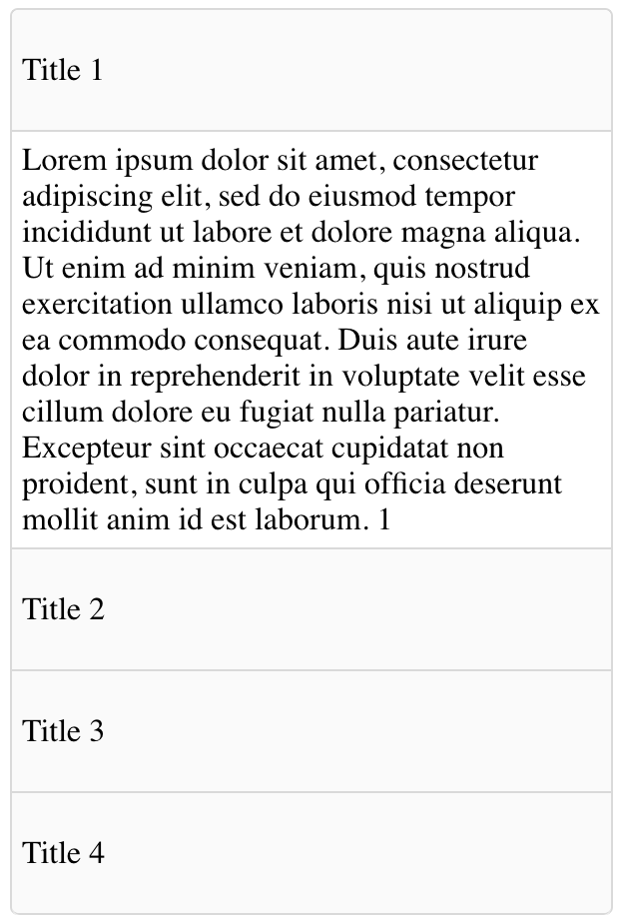

Slide 14
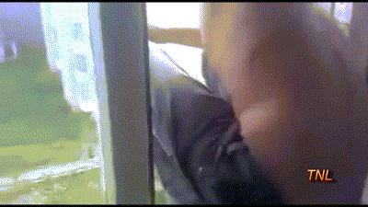
Погнали

Slide 15
Окружение
babel/typescript/flow
webpack
CRA

Slide 16
React
JSX
ReactDom.render
Component
attributes/props/className/style

Slide 17
Virtual DOM

Slide 18
State
Handlers

